Slide 1
Groundwater in urban slums
Dr Jenny Grönwall
SIWI

Slide 2


Experimenting with practical Transition Groundwater management strategies for the Urban Poor in Sub-Saharan Africa
(T-GroUP)
2

Slide 3
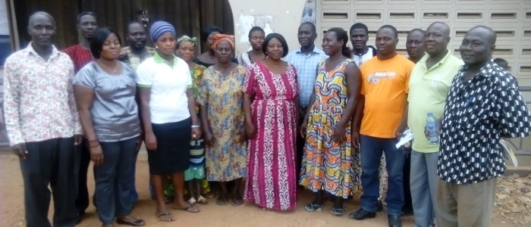
Potential in groundwater for development through focus on the users

Slide 4
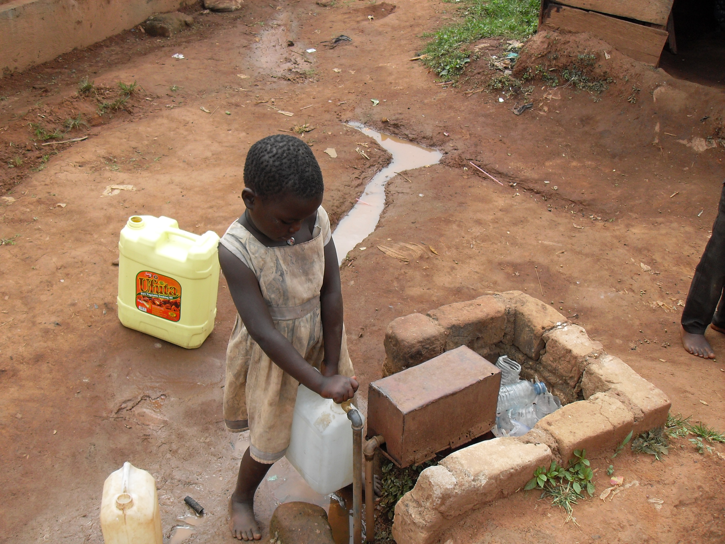
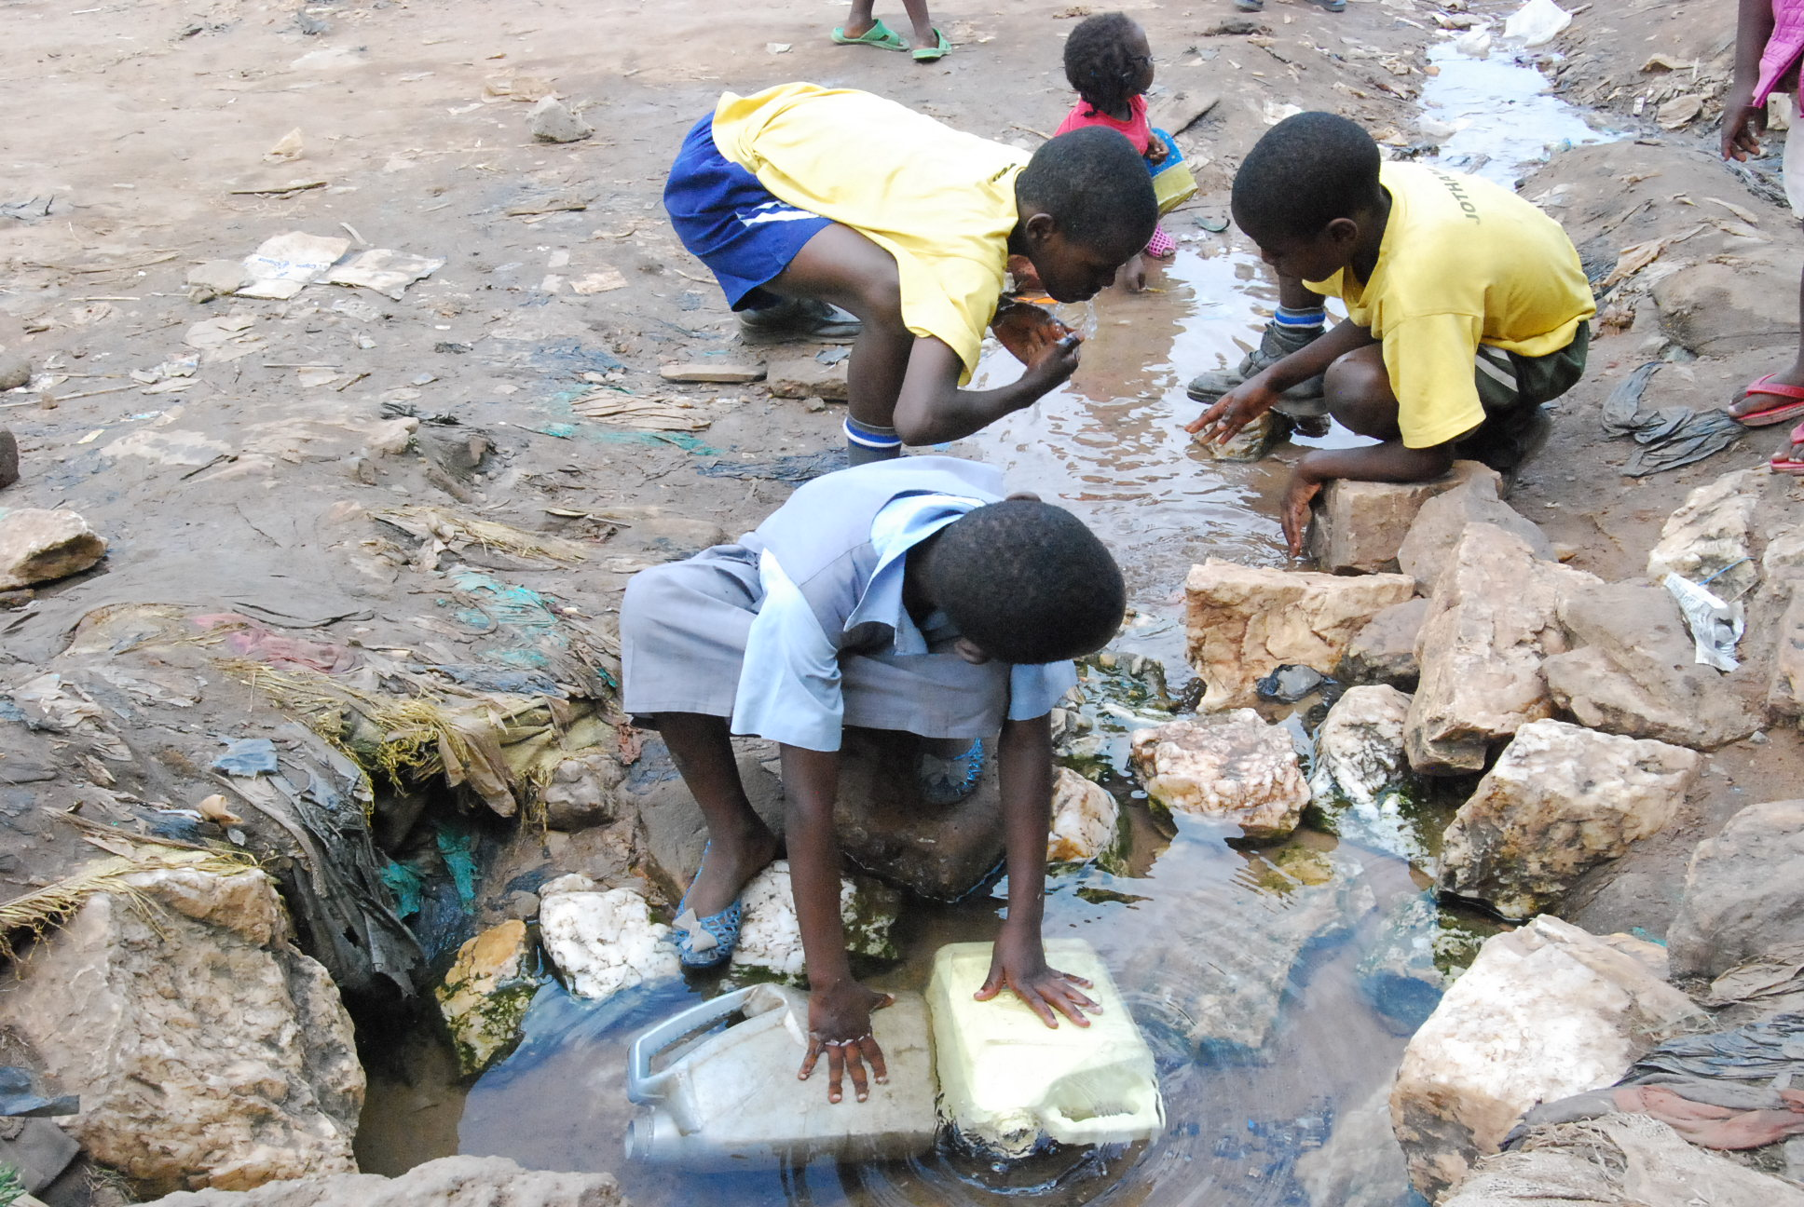
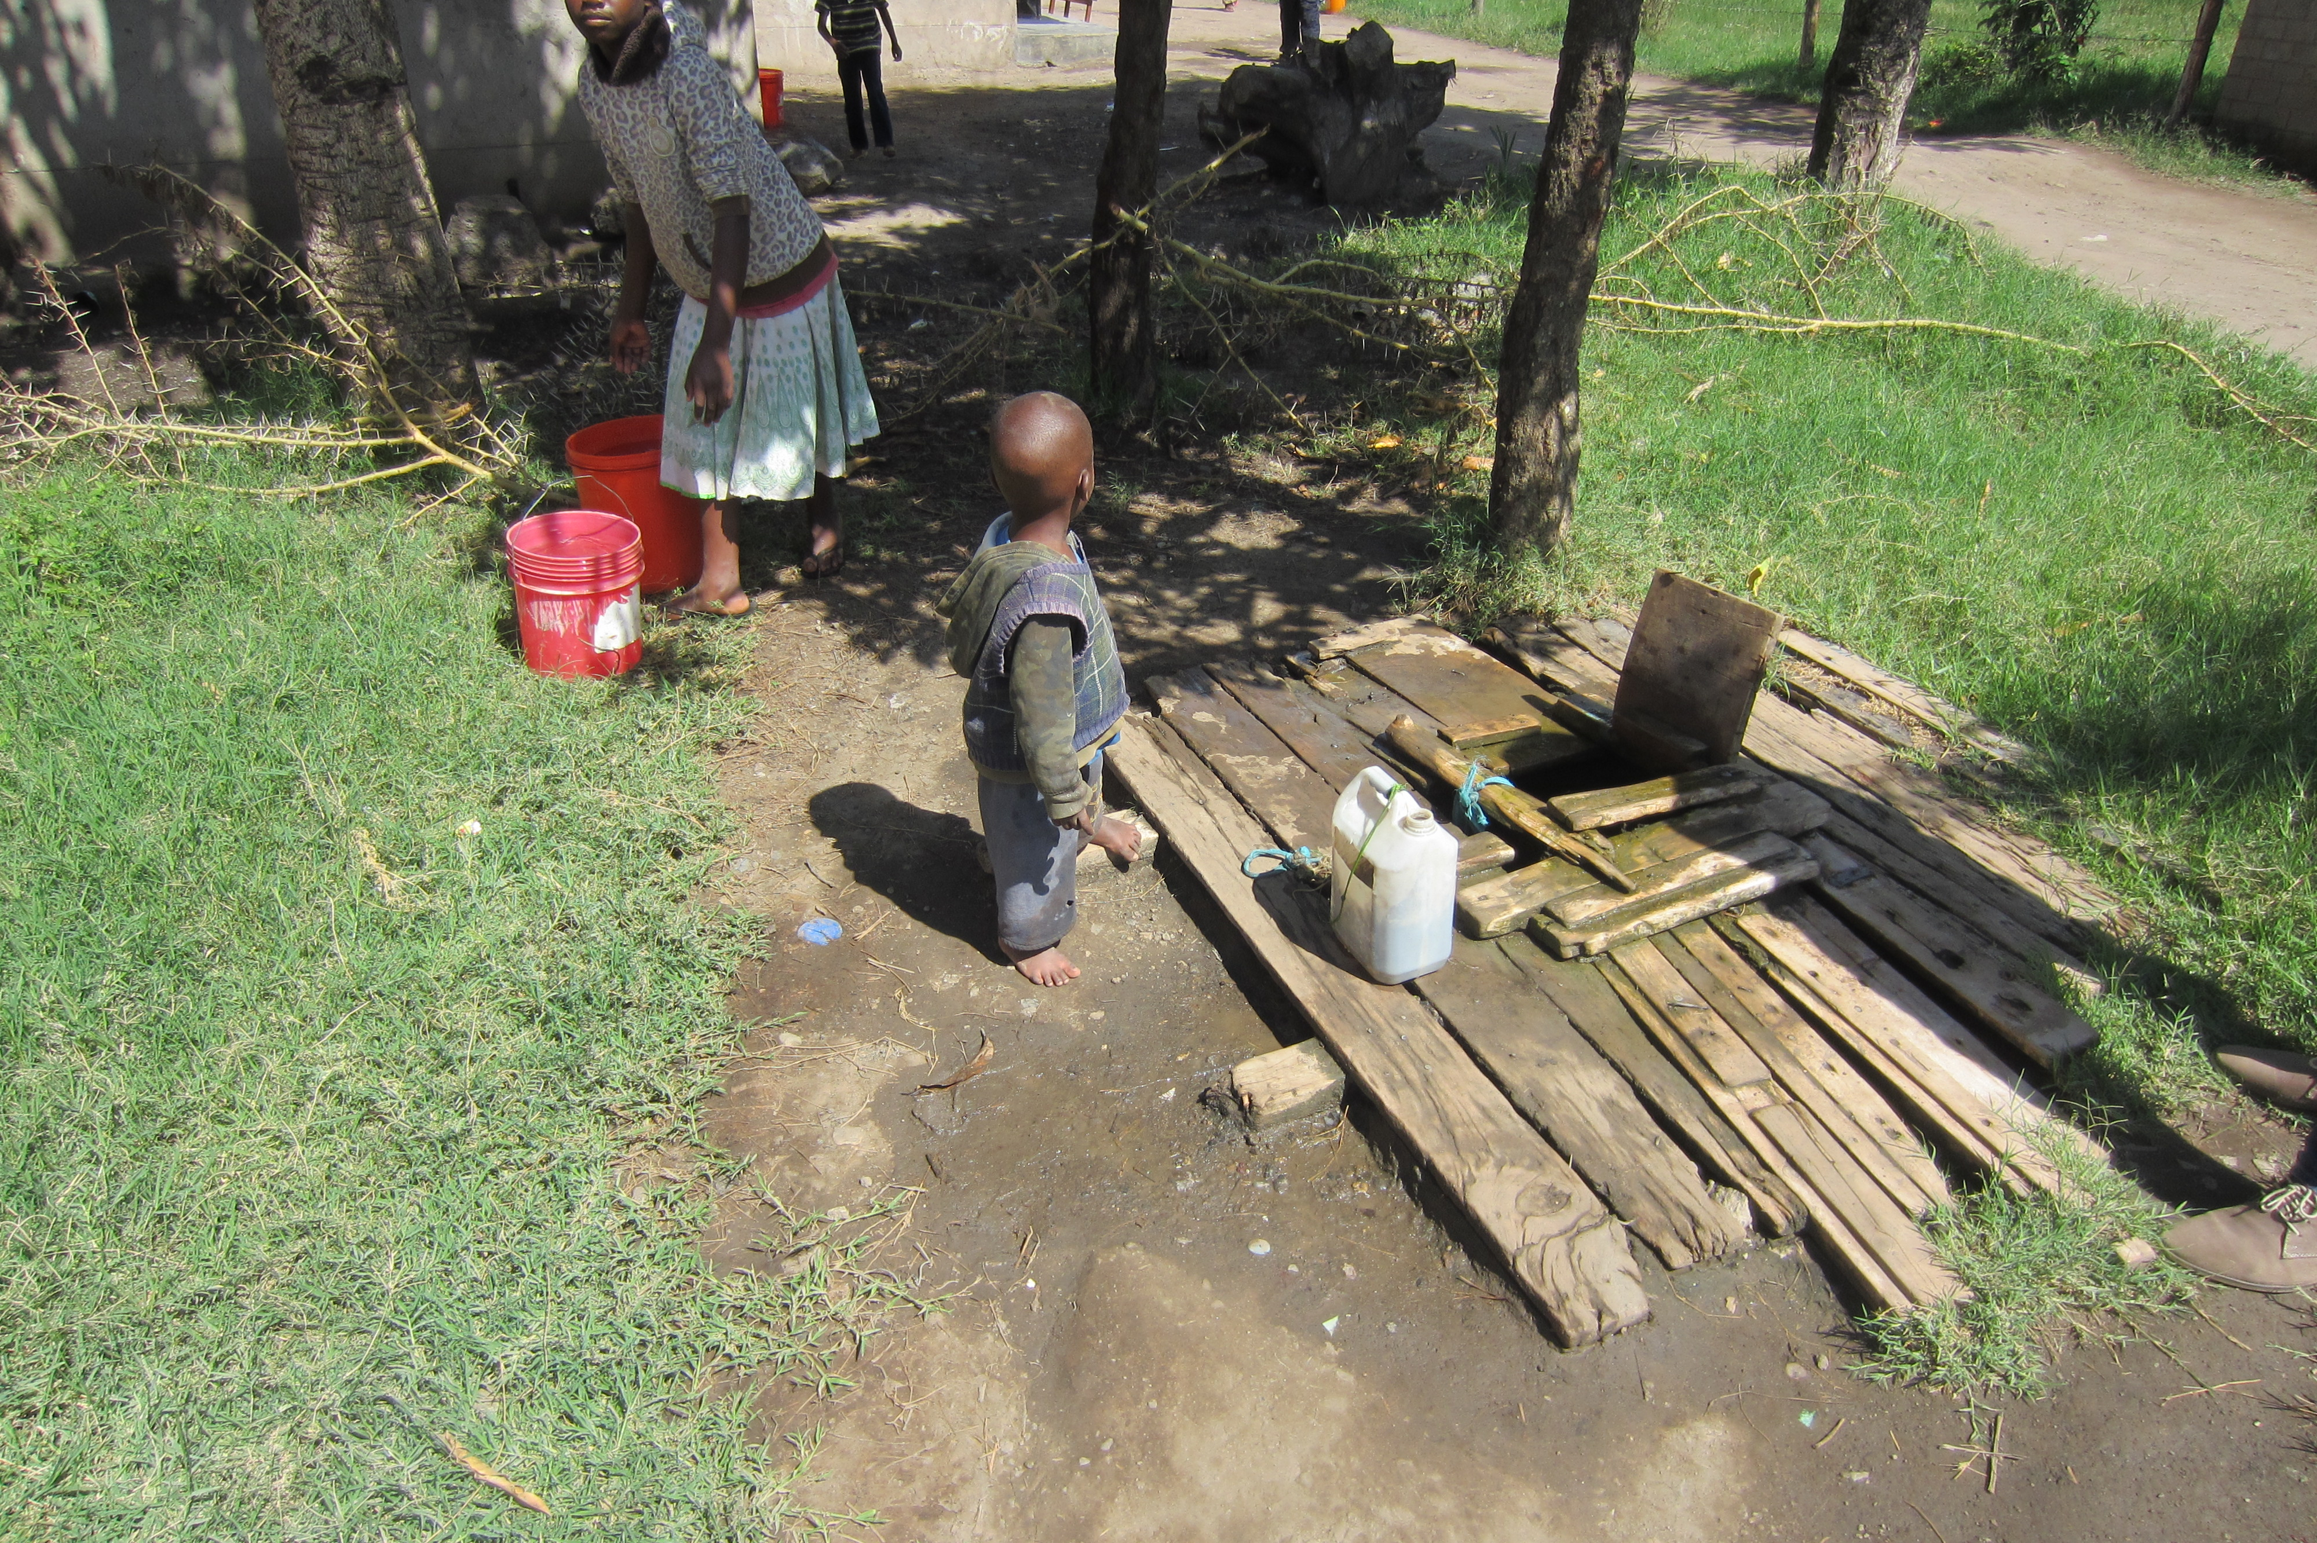
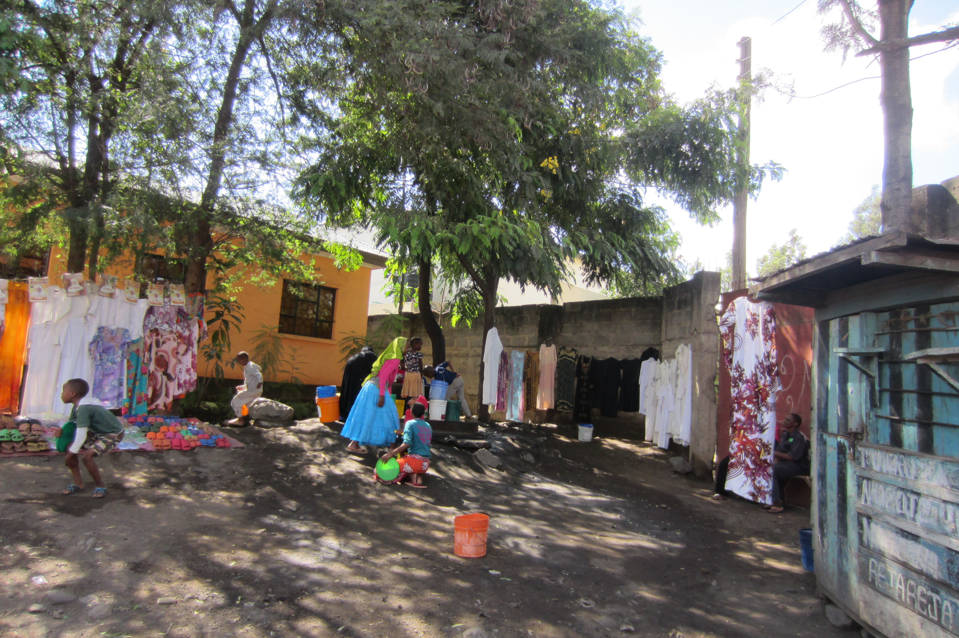
Groundwater and the urban poor
Inadequate (piped & public) water services in slums in Sub-Saharan Africa (SSA)
269M urban dwellers depend on wells as their
principal source;
Urban poor rely in part or in full on groundwater;
Public standpipes, springs, private vendors,
self-supply from own or shared wells,
and/or NGO-run kiosks (Grönwall et al., 2010)

Slide 5
Groundwater and the urban poor, cont’d
From 2010 to 2050: urban population from 300 million to
> 1 billion. Mostly slums/informal areas – unplanned for.
Mixed groundwater use will remain, but:
  good / safe quality groundwater is scarce;
  no (or insufficient) institutions managing urban groundwater reserves (especially with regards to CC);
  → (un)sustainable ?
How to move away from non-managed unsustainable practices towards sustainable urban groundwater management, which takes the interests of slum dwellers into consideration??

Slide 6
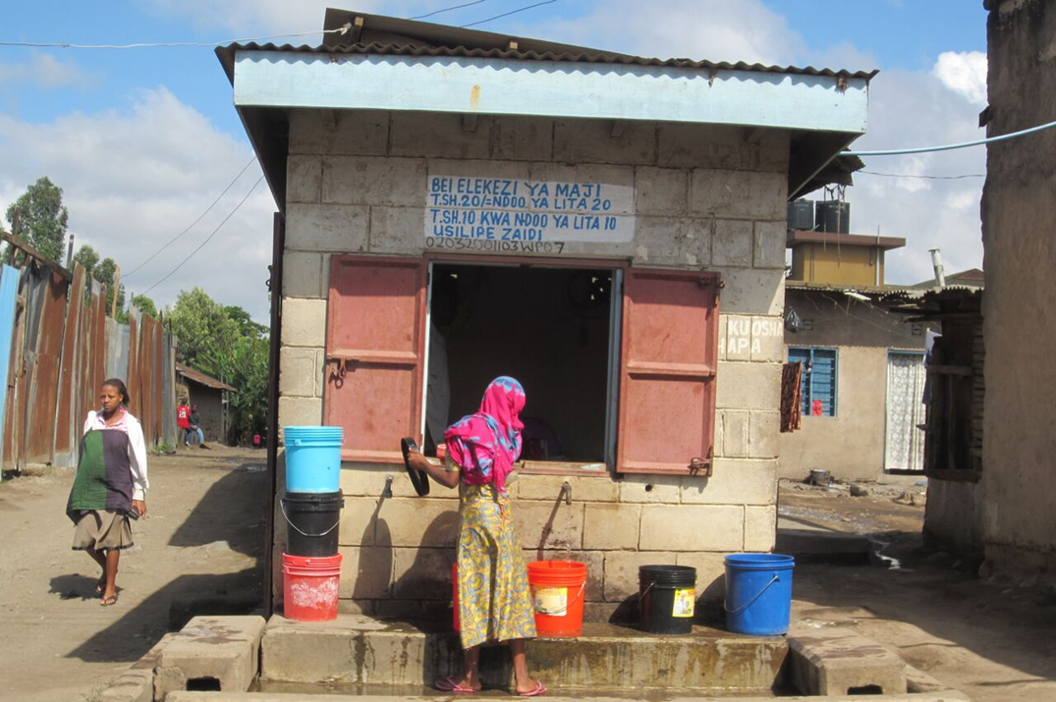
Key question 1
What are the relationships (over time and within a defined area) between above-ground and below-ground systems? What changes have been decisive?

Slide 7
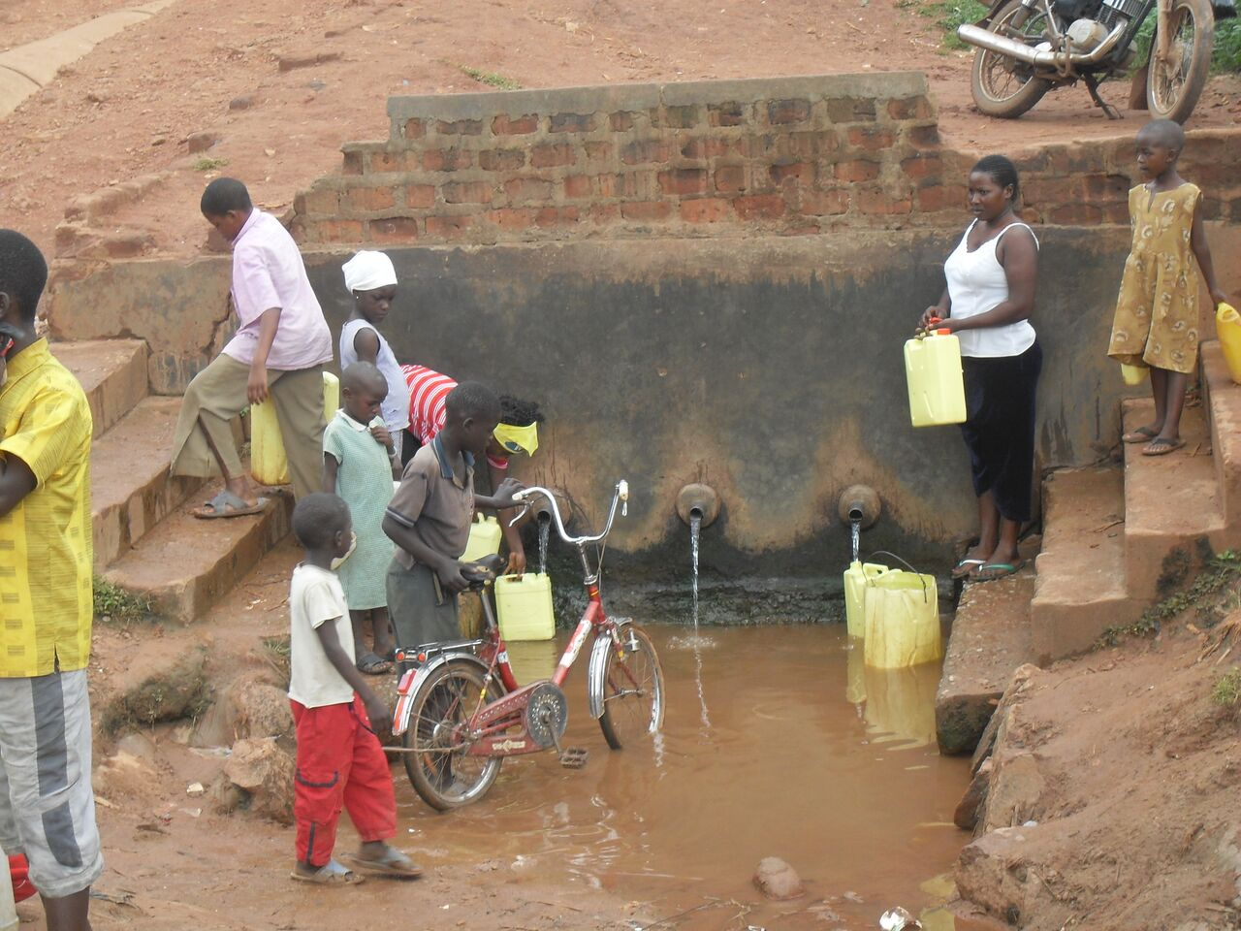
Key question 2
Can Transition Management (TM) become a model for urban groundwater governance in Sub-Saharan Africa, and how can it be tailored and improved?

Slide 8
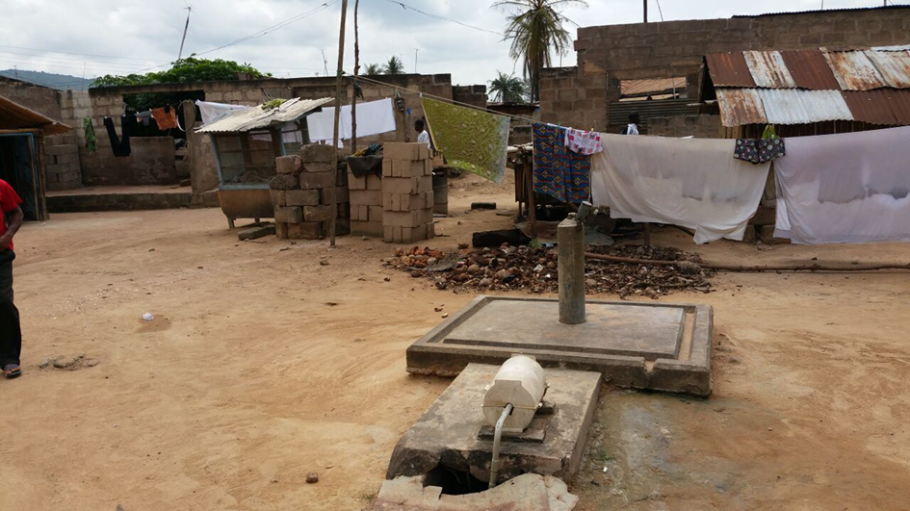
Focus areas
3 slums or low-income areas
– our ‘urban laboratories’:
Sombetini slum (Arusha, Tan)
Dodowa (Accra, Gh)
Bwaise
(Kampala, Ug)

Slide 9
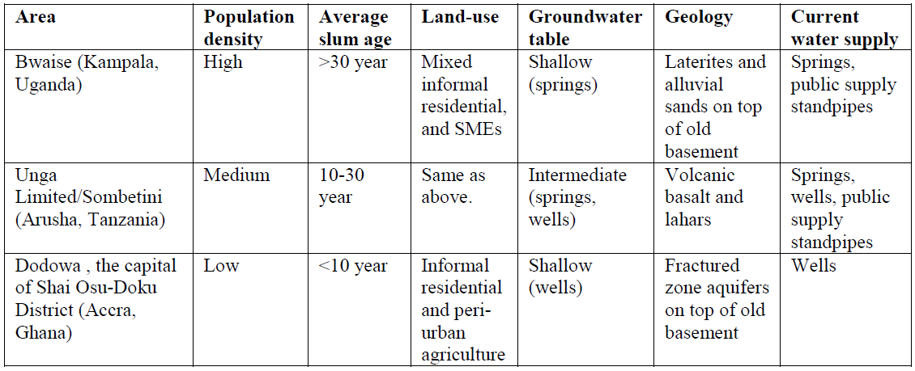
Characteristics of the focus areas

Slide 10
Slums as complex adaptive systems (CAS)
Characteristics
Complex: Many interacting ‘dimensions’ : social, political, legal, economical,
religious, environmental, infrastructural, etc.
Self-organizing: Emerge from elements making up the system
Adaptive: Ability to change their behavior and adapt to new relationships
Dynamic: Can undergo rapid and unpredictable transformations
Co-evolving: Change and are changed by their environment

Slide 11
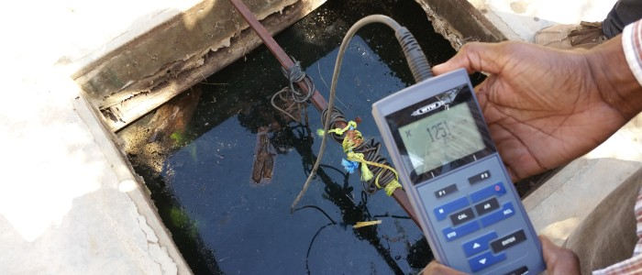
Systems above and below ground
Hydrogeology: drilling, aquifer characterization, network design, piezometer installation, automated monitoring (e.g. arduinos)
Groundwater quality: chemistry and viral pathogens, perhaps pharmaceuticals

Slide 12
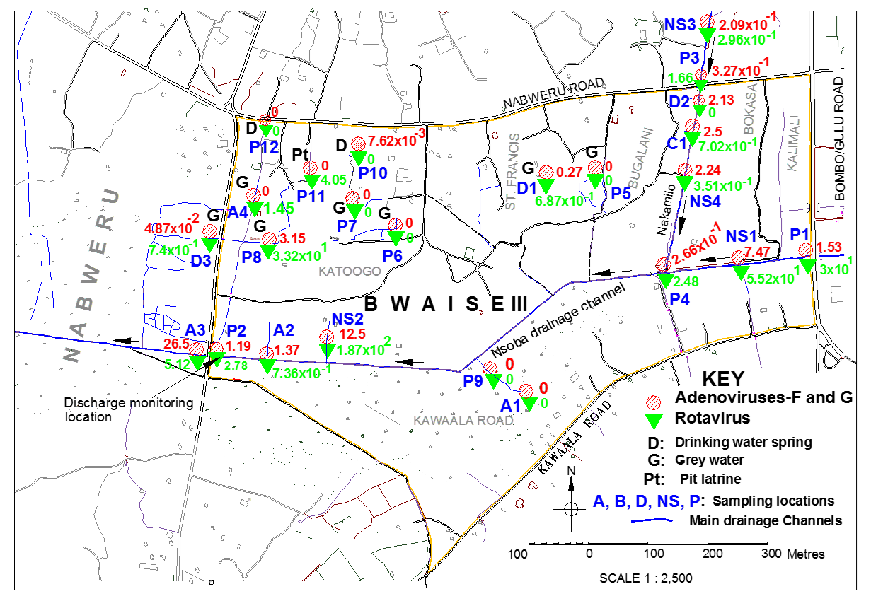
Selected viruses (gc/ml) Bwaise slum

Slide 13
Governance and economics
Management and governance, law and policy, social norms and power dynamics
Economics: (qualitative and quantitative) surveys among users and producers of groundwater, formal or informal operators (households, informal and formal private water vendors, state-owned enterprises or utilities).

Slide 14
Urban groundwater governance
Who gets groundwater, when and how?
Map actors and stakeholders at different levels, the processes for planning and decision making, the institutions, the norms and regulations…
Evaluate the level of transparency, accountability, participation and integrity in decision making (criteria of good governance)

Slide 15
Transition
Shifts from one regime to another;
Structural change in the way a societal system operates. Long-term process (25-50 years)
resulting from a co-evolution of cultural, institutional, economical, ecological and technological processes and developments on various scales (multi-level)

Slide 16
Transition management
A social learning protocol aimed at making controlled and intentional changes in a societal CAS in order to create or spark a system change;
Recognized during SWITCH (www.switchurbanwater.eu)
Existing practical toolbox of participatory techniques;
Easy to include water governance issues;
But:
Never applied to urban groundwater governance;
Never applied to SSA;
Framework of power dynamics poorly developed

Slide 17
TM cycle in an S-curve

Slide 18
Who is doing this?
The Learning Alliance

Slide 19
Characteristics of the Learning Alliance
10-15 people;
Multi-sectoral, multi-level urban frontrunners;
Will use information gathered in 1st phase;
Learn from each other’s knowledge and perspectives (social learning);
Integration of ideas into set of transition experiments

Slide 20
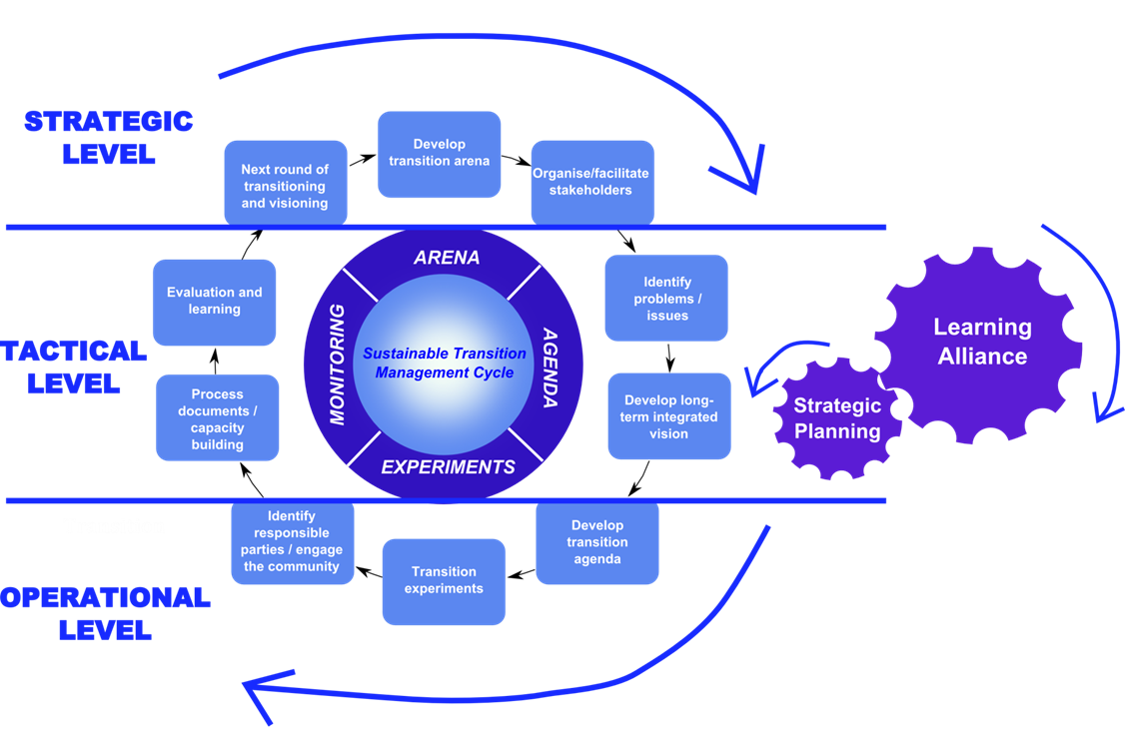
TM activities
Action-oriented research: carry out the social learning protocol

Slide 21
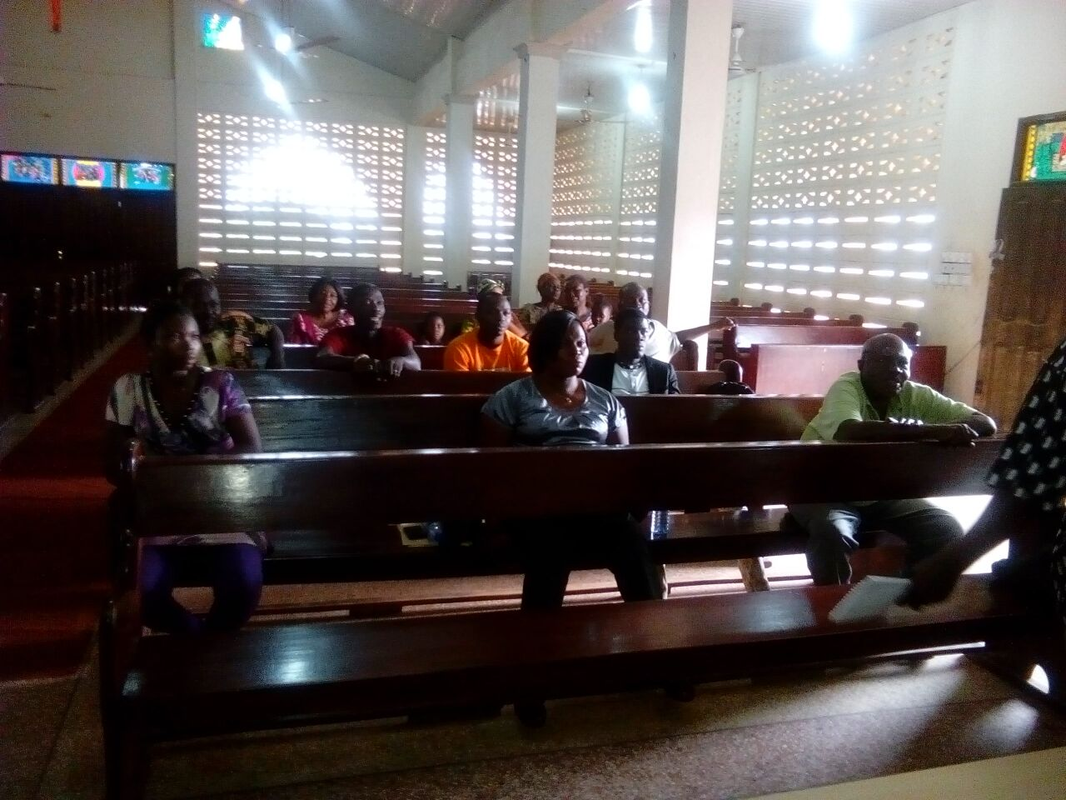
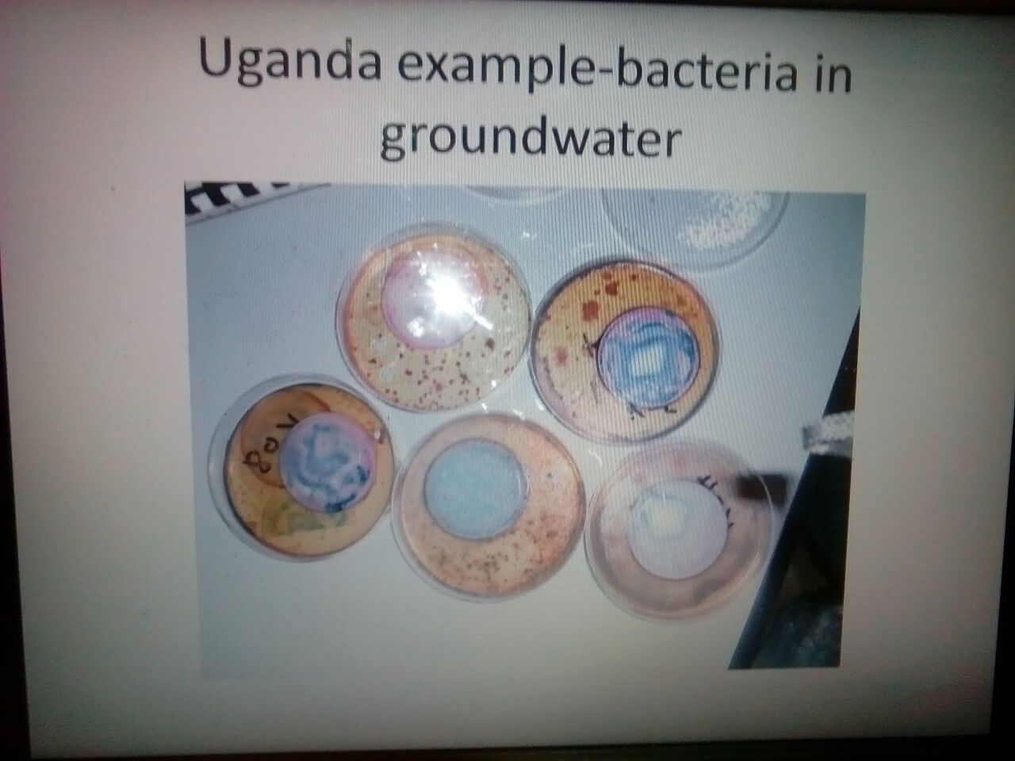
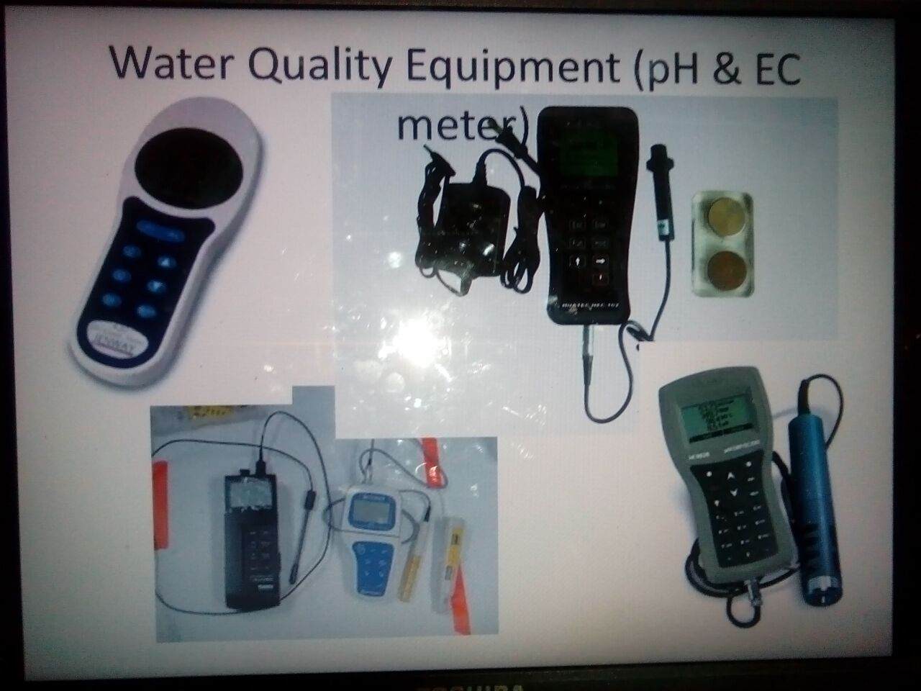
Learning has already begun…

Slide 22
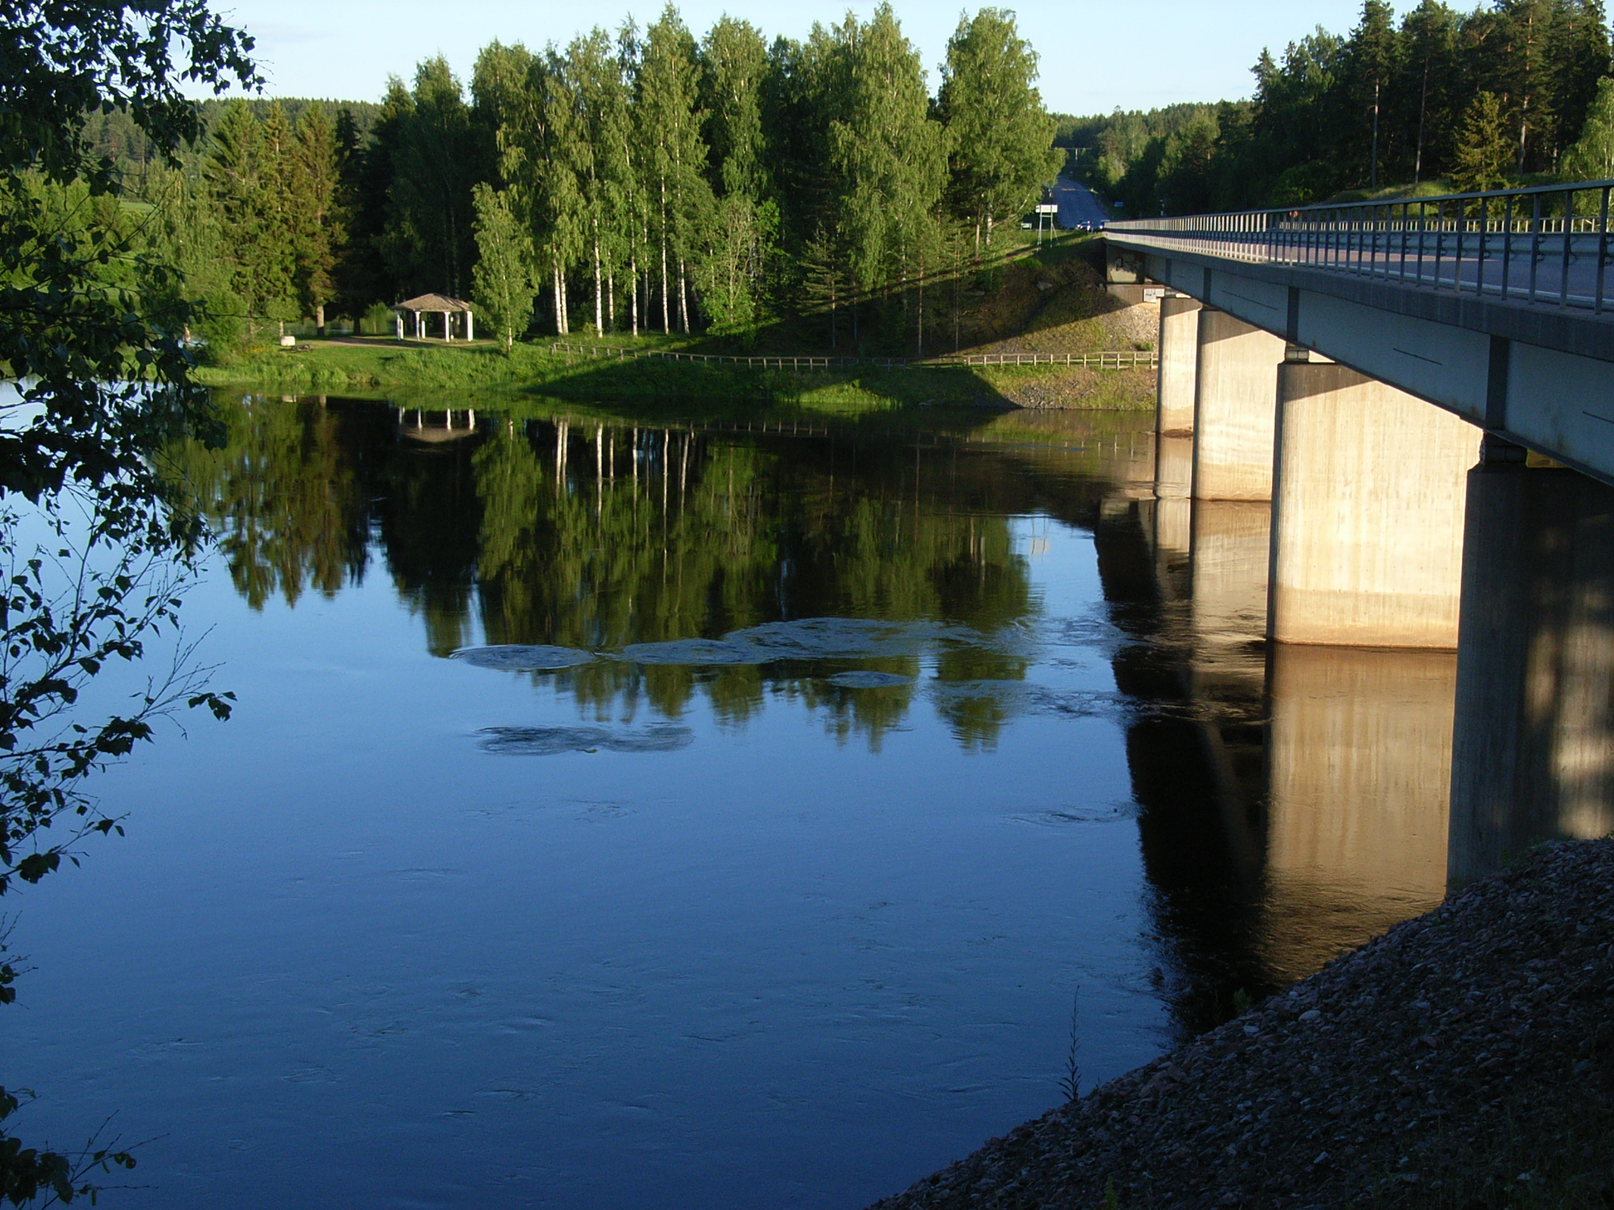
Thank you!
jenny.gronwall@siwi.org
http://t-group.science/
www.UPGro.org

